Slide 1
18CSC301T FORMAL LANGUAGE AND AUTOMATA
UNIT II
Context free grammar and Language

Slide 2
Unit 2
Context Free Grammar and Language
CNF
GNF
Formal Form
Elimination of useless symbols
Elimination of unit productions
Elimination of Null production
Introduction and Types of grammar
Simplification of context free grammar
Ambiguity
Derivation

Slide 3
S1
1)Introduction – Grammar , Types of grammar(Chomosky hierarchy)
2) Context free Grammar
3) Examples of CFG
4)Application of CFG
5)Context Free Language
6) Derivation of CFG

Slide 4
Introduction to Grammar

Slide 5
Grammars: Introduction
Grammars denote syntactical rules for conversation in natural languages.
Eg : SVO pattern in english
Noam Chomsky gave a mathematical model of grammar in 1956.
A grammar is a set of production rules which are used to generate strings of a language.
Eg: <digit> : 0|1|2|3|4|5|6|7|8|9
A grammar can be represented as 4 tuples (N, T, P, S) Where,
N:- Set of Non terminals or variable list
T:- Set of Terminals(T∈ ∑)
S:- Special Non terminal called Starting symbol of grammar( S ∈ N)
P:- Production rule ( of the form α → β , where α and β are strings on N ∪ ∑ )

Slide 6
Two basic elements of a Grammar
Terminal symbols
Non-terminal symbols
Terminal Symbols-
Terminal symbols are denoted by using small case letters such as a, b, c etc.
Terminal symbols are those which are the constituents of the sentence generated using a grammar.
Non-Terminal Symbols-
Non-Terminal symbols are denoted by using capital letters such as A, B, C etc.
symbols which can be replaced
Non-Terminal symbols are those which take part in the generation of the sentence but are not part of it.
Non-Terminal symbols are also called as variables.

Slide 7
Example
Example: Grammar G1
P1: S → AB
P2: A → a
P3: B → b
G1= (N,T,P,S) = ({S, A, B}, {a, b}, {p1,p2,p3}, S)
Where,
S, A, and B are Non-terminal symbols
a and b are Terminal symbols
S is the Start symbol, S ∈ N
p1,p2,p3 – are Production rules

Slide 8
Types of Grammar

Slide 9
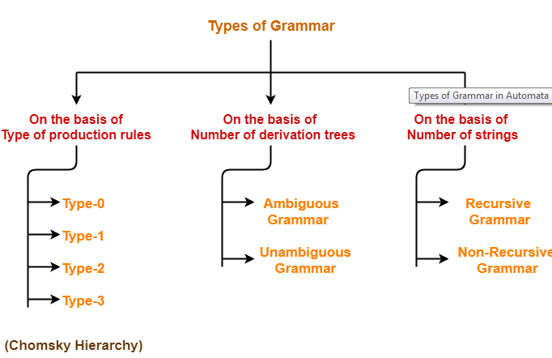
Types of Grammar

Slide 10
Chomosky Hierarchy
According to Noam Chomosky, there are four types of grammars
Type 0, Type 1, Type 2, and Type 3.
Type 0 known as unrestricted grammar.
Type 1 known as context sensitive grammar.
Type 2 known as context free grammar.
Type 3 Regular Grammar.

Slide 11
Type 0: Unrestricted Grammar:
Type-0 grammars include all formal grammars.
Type 0 grammar languages are recognized by Turing Machine.
These languages are also known as the Recursively Enumerable languages.
Grammar Production in the form of α → β
where
α is ( V + T)* V ( V + T)* V : Variables/NT T : Terminals.
β is ( V + T )*.
In type 0 there must be at least one variable on Left side of production.
Example1 : Example2 :
Sab –> ba S → ACaB A –> S. Bc → acB
Here, Variables are S, A and Terminals a, b. CB → DB
aD → Db

Slide 12
Type 1: Context Sensitive Grammar
Type-1 grammars generate the context-sensitive languages.
The language generated by the grammar are recognized by the Linear Bound Automata(LBA)
Rules:
First of all Type 1 grammar should be Type 0.
Grammar Production in the form of α → β
Where,
α , β is ( V + T )+.
| α | <= | β |
i.e count of symbol in α is less than or equal to β
Example: 1 Example: 2 S –> AB AB → AbBc AB –> abc A → bcA B –> b B → b

Slide 13
Type 2: Context Free Grammar:
Type-2 grammars generate the context-free languages.
The language generated by the grammar is recognized by a Pushdown automata (PDA)
Rules:
First of all it should be Type 1.
Left hand side of production can have only one variable.
Grammar Production in the form of α → β
Where,
α is Single NT
β is ( V + T )*.
| α | <= | β |
i.e count of symbol in α is less than or equal to β
Example
S –> AB A –> a/ε B –> b

Slide 14
Type 3: Regular Grammar:
Type-3 grammars generate regular languages.
These languages can be accepted by a finite state automaton (FA)
Type 3 is most restricted form of grammar.
The productions must be in the form
X → Aa/a
X → aA/a
where,
X,A is Non Terminal
a ∈ ∑ *
Example
S->aS/b
S->aS/c
S->Sa/b
A->ba/ ε

Slide 15
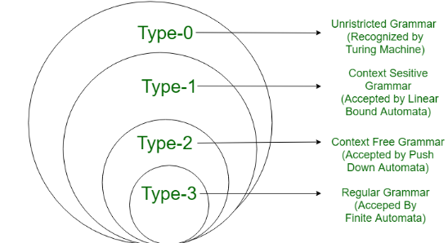
Contd…

Slide 16
Context Free Grammar

Slide 17

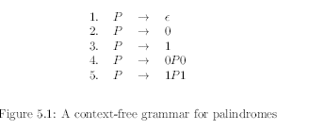
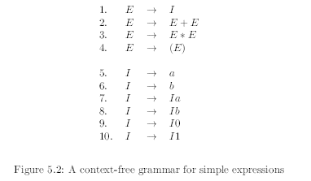
Informal Example
Language of palindrome
Eg: MADAM, palindromes with alphabet{0,1} → 0110,11011
Not a regular Language → proved by pumping lemma
Cannot be defined by regular grammar

Slide 18

Formal definition
Context free grammar G can be defined by four tuples as:
(N, T, P, S)
N:- Set of Non terminals or variable list
Eg: P(from previous palindrome example)
T:- Set of Terminals(T∈ ∑)
Eg:{0,1} (from previous palindrome example)
S:- Special Non terminal called Starting symbol of grammar( S ∈ N)
Eg: P(from previous palindrome example)
P:- Production rule ( of the form α → β , where α and β are strings on N ∪ ∑ )

Slide 19
Application

Slide 20

Parser in Compile Design
Parser → represents the structure of the Program by parse tree.
Case Study:
Grammar to generate balanced Parenthesis

Slide 21
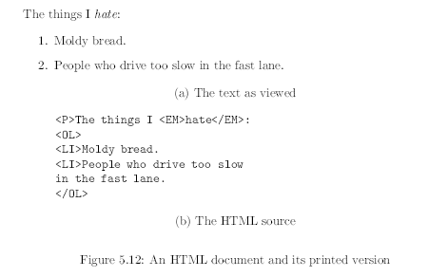
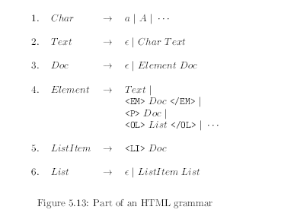
2. Markup Language

Slide 22
3. Document Type Definition(Assignment 2.4)
Explore How GFG is applied in Document type Identification

Slide 23
Context Free language

Slide 24

Formal definition

Slide 25
Derivation & Parse Tree

Slide 26
Derivations
Starting with the start symbol, non-terminals are rewritten using productions until only terminals remain.
Any terminal sequence that can be generated in this manner is syntactically valid.
If a terminal sequence can’t be generated using the productions of the grammar it is invalid (has syntax errors).
The set of strings derivable from the start symbol is the language of the grammar (sometimes denoted L(G)).
Derivation is a sequence of production rules.
It is used to get the input string through these production rules.

Slide 27
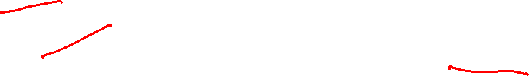
Contd…
During parsing, we need to take the following two decisions.
Need to decide the non-terminal which is to be replaced.
Need to decide the production rule by which the non-terminal will be replaced.
Based on the following 2 derivations, We have two options to decide which non-terminal to be placed with production rule .
Left most Derivation
Right most Derivation
To illustrate a derivation, we can draw a derivation tree (also called a parse tree)

Slide 30
Left most Derivation
In the leftmost derivation, the input is scanned and replaced with the production rule from left to right.
So in leftmost derivation, we read the input string from left to right.
Leftmost non-terminal is always expanded.
Example:
E = E + E Rule1
E = E - E Rule2
E = a | b Rule3
The leftmost derivation is:
W= a - b + a
E = E + E
E = E - E + E
E = a - E + E
E = a - b + E
E = a - b + a

Slide 31
Rightmost Derivation
In rightmost derivation, the input is scanned and replaced with the production rule from right to left.
So in rightmost derivation, we read the input string from right to left.
Rightmost non-terminal is always expanded.
Example:
E = E + E Rule1
E = E - E Rule2
E = a | b Rule3
The rightmost derivation is:
W=a - b + a
E = E - E
E = E - E + E
E = E - E + a
E = E - b + a
E = a - b + a

Slide 32
Parse tree
Parse tree is the graphical representation of symbol. The symbol can be terminal or non-terminal.
In parsing, the string is derived using the start symbol.
The root of the parse tree is that start symbol.
All leaf nodes have to be terminals.
All interior nodes have to be non-terminals.
In-order traversal gives original input string.

Slide 33
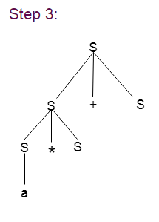
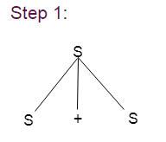
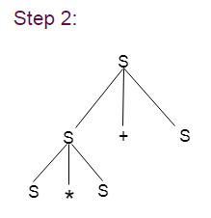
Example:
Grammar G :
S → S + S | S * S
S → a|b|c
Input String : W=a * b + c
Parse Tree for Left most Derivation

Slide 34
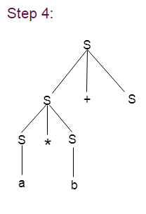
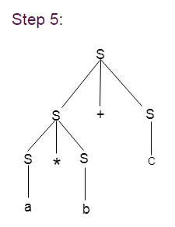
Contd…

Slide 35
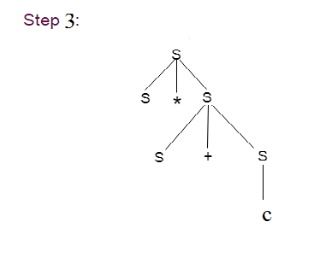
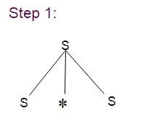
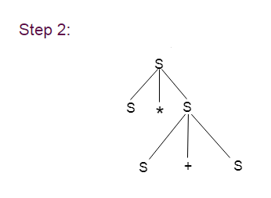
Contd…
Input String : W=a * b + c
Parse Tree for Right most Derivation

Slide 36
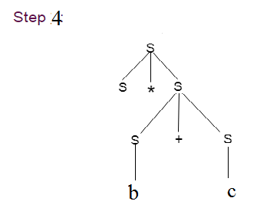
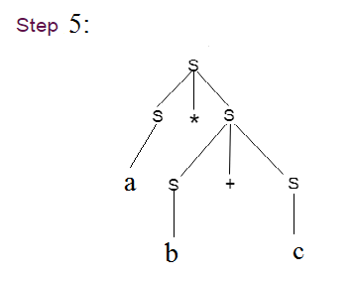
Contd…

Slide 38

What is the language defined by ‘G’
G : S →aS/bS/a/b
L(G) = (a+b)⁺
G : S →XaaX
X →aX/bX/ ε
L(G) = (a+b)* aa (a+b)*
G : S → SS
L(G) =

Slide 39
Contd…
G : S →aca
c →aca/b
S → aca
→ aacaa
→ aaacaaa
→ aaabaaa
L(G) = a^{n} b a^{n}
G : S →0S1/ ε
S → 0S1
→ 0 0S1 1
→ 0 00S11 1
→ 0 0011 1
L(G) = 0^{n} 1^{n} | for n>=0;

